Slide 1





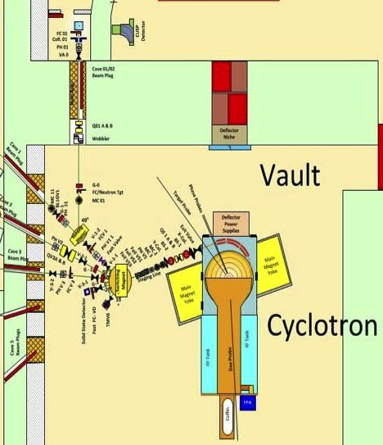
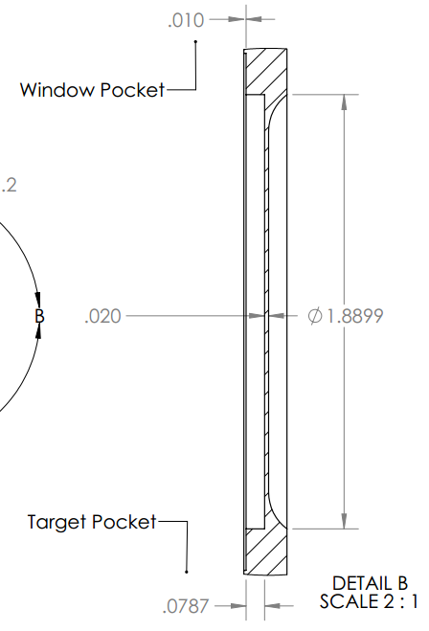
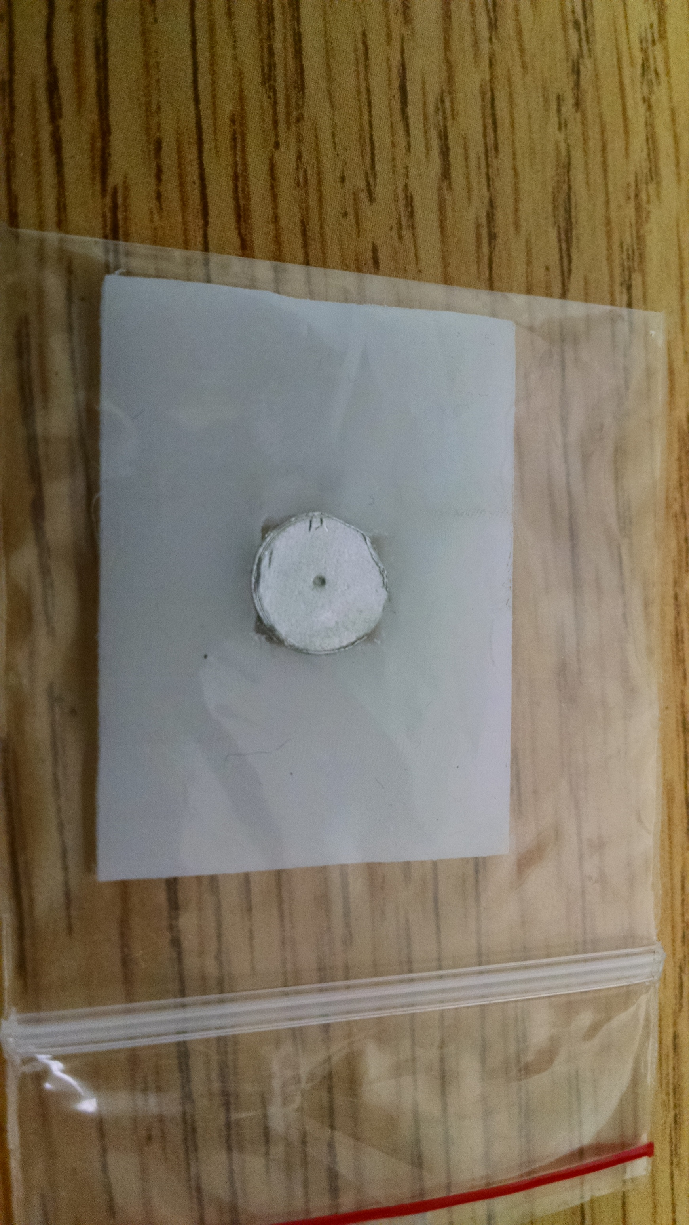
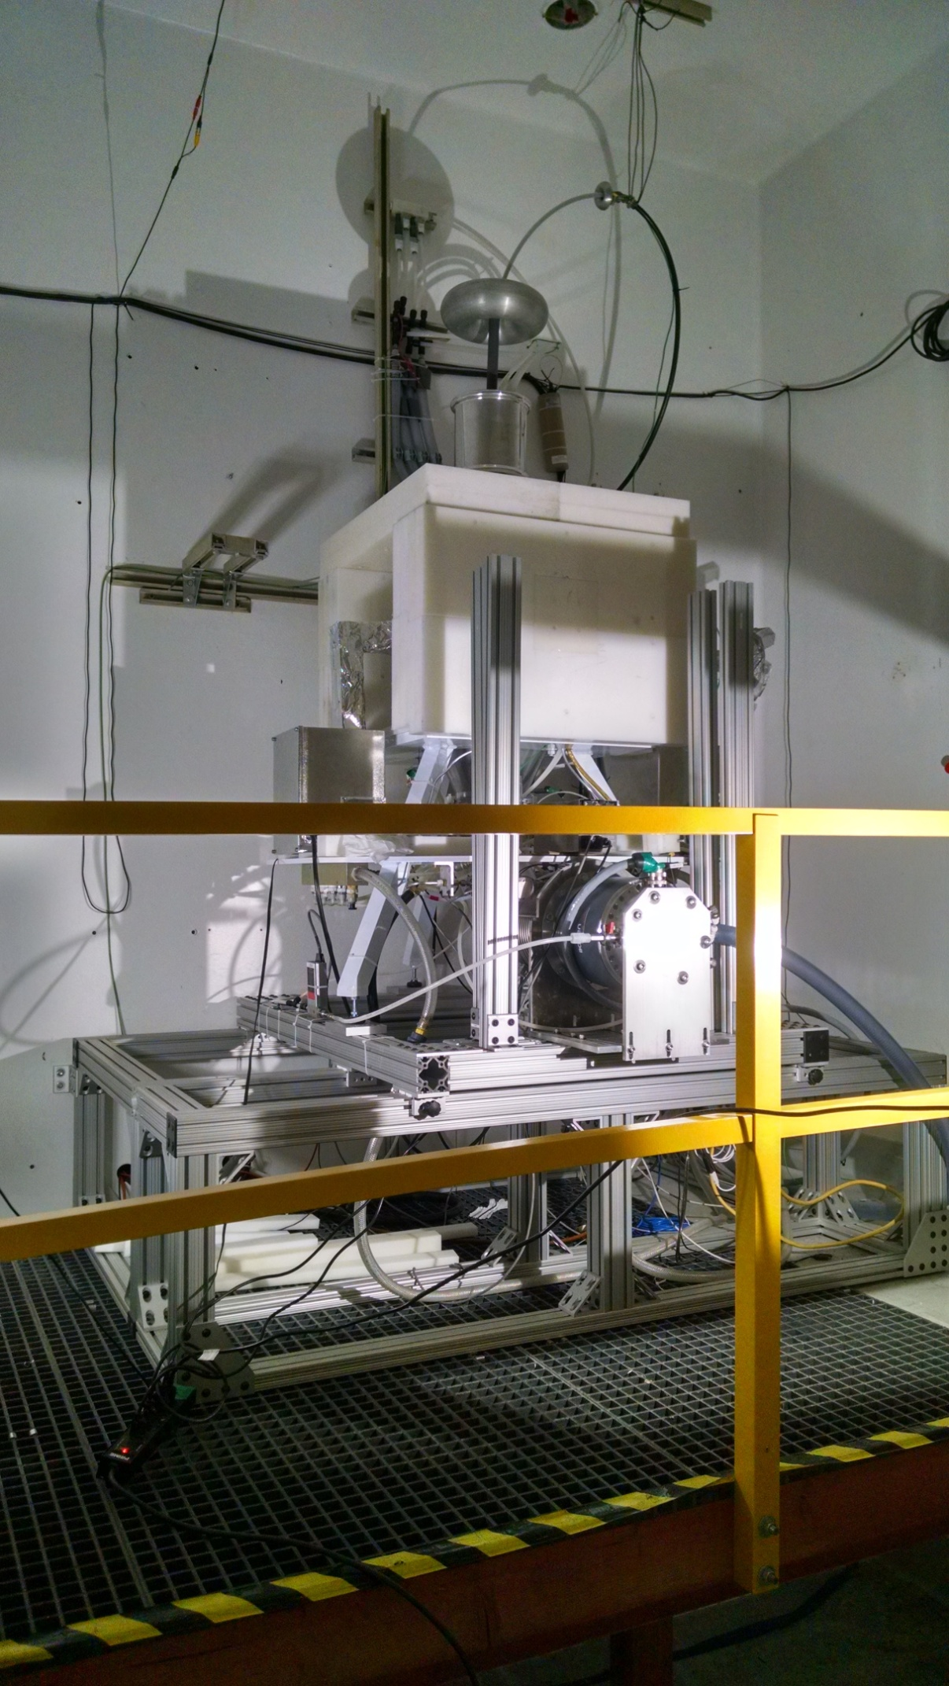
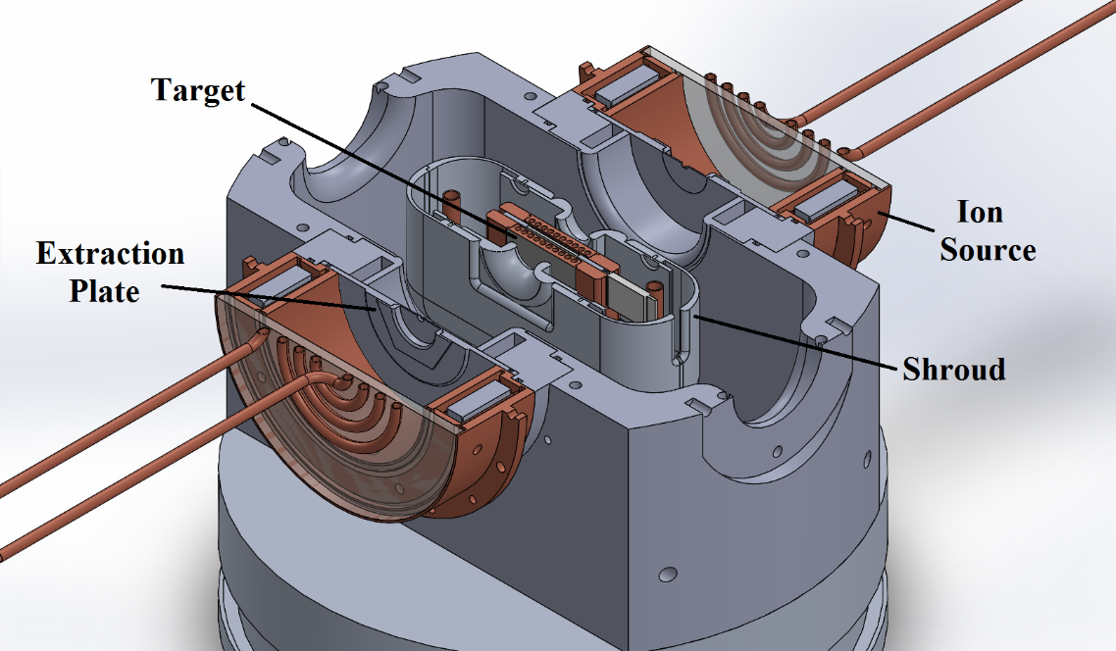


Neutron Cross-Sections for Radionuclide Production
A.S. Voyles^{a,b}, M.S. Basunia^{b}, J.C. Batchelderª, J.D. Bauer^{c}, L.A. Bernstein^{a,b}, E.F. Matthews^{a,b}
ª Nuclear Science and Security Consortium – The University of California, Berkeley
^{b} Lawrence Berkeley National Laboratory, ^{c} Lawrence Livermore National Laboratory
AT A GLANCE
Sample irradiAtion
(n,p) cross sections
FUTURE WORK
.The UC Berkeley High-Flux Neutron Generator has been used to irradiate Zn and Ti at fast fission-like energies.
Decay spectroscopy following (n,x) reactions provides precise cross sections in ratio to known dosimetry standards.
(n,p) reactions provide mCi quantities of radionuclides for national security, forensics and medical applications.
The HFNG is a D-D fusion neutron generator capable of producing an internal flux of approximately 10⁸ , with a flux-averaged neutron energy of 2.55 MeV for target foils loaded into the generator.
Continue production cross sections measurements for emerging medical radioisotopes: ⁴⁷Ca, ⁶⁷Cu, ⁸⁹Sr, ¹⁰⁵Rh, ¹⁴⁹Pm, ¹⁵⁹Gd, ¹⁶¹Tb, ¹⁶⁶Ho, ¹⁶⁹Er, ¹⁷⁵Yb, ¹⁷⁷Lu, ^{193m}Pt.
Extension of measurements up to 55 MeV by developing ⁷Li(p,n) capabilities at the LBNL 88 Inch Cyclotron.
Figure 5. Planar LEPS gamma-ray spectra for ⁴⁷Sc and ^{115m}In
⁷Li(p,n) neutron
production target
Figure 8. ⁷Li(p,n) source development schematic
Research Goals
⁴⁷Ti(n,p)⁴⁷Sc and ⁶⁴Zn(n,p)⁶⁴Cu production cross sections have been successfully measured through neutron activation at the UC Berkeley HFNG.
Expand cross section libraries for radionuclide production, as a part of the U.S. Nuclear Data Program by measuring production cross sections:
On structural materials for national security applications (Zn, Ti).
For emerging medical isotopes and radiochemical tracers, via (n,p).
Figure 2. MCNP-modeled neutron energy distribution for the HFNG.
Conclusions
This work focuses on (n,p) production of the emerging medical radionuclides ⁶⁴Cu and ⁴⁷Sc:
⁶⁴Cu (t_{1/2} = 12.7 h via β⁻ and β⁺ ) is a diagnostic and therapeutic radionuclide.
⁴⁷Sc (t_{1/2} = 3.35 d via β⁻) production is a potential solution to the ^{99m}Tc shortage, with its similar high-intensity 159-keV gamma.
The capability to precisely measure relative (n,p) cross sections to within 5% uncertainty has been clearly demonstrated.
Measurements are consistent with existing data and models.
Continued measurement of (n,p) cross sections provides:
Valuable activation data at fast fission-like energies, useful for forensics and nonproliferation applications and testing.
Expanded nuclear medicine capabilities through precise dose deposition, as well as patient-specific treatments.
More efficient and affordable production of radionuclides for various applications, as a proliferation-resistant alternative to production in HEU-fueled reactors.
Improved fidelity of reaction modeling codes, used for estimating cross sections by comparison to measured data.
Introduction
Figure 6. Measured lifetimes show strong agreement with ENSDF.
Production cross sections for many emerging medical radioisotopes currently have unacceptably large uncertainties. Compact neutron generators allow for precise (n,p) cross section measurements, and offer a proliferation-resistant pathway for radioisotope production, with simplified radiochemical product separation. This work focuses on the irradiation of Titanium and Zinc foils using the UC Berkeley High Flux Neutron Generator (HFNG).
Preliminary cross sections are consistent with experimental and evaluated data, as well as reaction modeling results from TALYS.
Cross sections have been measured for 2.764 MeV, + 0.015 MeV / - 0.022 MeV neutrons, to lower uncertainty than existing data.
Figure 3. Co-loaded foils for neutron activation.
Co-loading Indium foils removes flux dependence , allowing for (n,p) activity measurements to within anticipated uncertainties of 10%.
Decay spectra were used to quantify the (n,p) cross section, relative to the well-characterized ¹¹³In(n,n')^{113m}In and ¹¹⁵In(n,n')^{115m}In dosimetry standards, σ_{In}:
References
Figure 7a. Cross section data for the ⁶⁴Zn(n,p)⁶⁴Cu reaction.
H. F. Aly et al., Microchim. Acta, vol. 59, no. 1, 1971.
K. S. Bhatki et al., J. Radioanal. Chem., vol. 2, no. 1–2, 1969.
T. H. Bokhari et al., J. Radioanal. Nucl. Chem., vol. 283, no. 2, 2010.
J. F. Briesmeister et al., Los Alamos National Laboratory, 1986.
M. B. Chadwick,et al., Nucl. Data Sheets, vol. 107, no. 12, 2006.
A. J. Koning et al., AIP Conference Proceedings, 2005, vol. 769, no. 2.
M. R. Lewis et al., J. Nucl. Med., vol. 44, no. 8, Aug. 2003.
C. Müller et al., J. Nucl. Med., vol. 55, no. 10, Oct. 2014.
N. Otuka et al., Nucl. Data Sheets, vol. 120, 2014.
L. Pietrelli et al., J. Radioanal. Nucl. Chem., vol. 157, no. 2, 1992.
S. M. Qaim et al., IAEA Technical Reports Series No. 473, 2011.
D. Updegraff et al., “Nuclear Medicine without Nuclear Reactors or Uranium Enrichment,” 2013.
Decay
γ Branching Ratio
Measured Photopeak Intensity
Detector Efficiency
γ Attenuation
Figure 4. Fraction of total reactions induced in the Indium foil between the energies [0, E’]. The solid red boundaries indicate theenergy region that corresponds to 68.2% of the total activation.
Titanium and Zinc foils are co-loaded with Indium
for relative cross section
measurements
Acknowledgements
Figure 7b. Cross section data for the ⁴⁷Ti(n,p)⁴⁷Sc reaction.
This work has been carried out at the University of California, Berkeley, and performed under the auspices of the U.S. Department of Energy by Lawrence Livermore National Laboratory under contract DE-AC52-07NA27344 and Lawrence Berkeley National Laboratory under contract # DE-AC02-05CH11231. Funding has been provided from the US Nuclear Regulatory Commission, the Nuclear Science and Security Consortium, and the US Nuclear Data Program.
Figure 1. The UC Berkeley High Flux Neutron Generator

